Slide 1
MentalHealth
File created on: 7/5/2023 9:21:34 AM

Slide 2
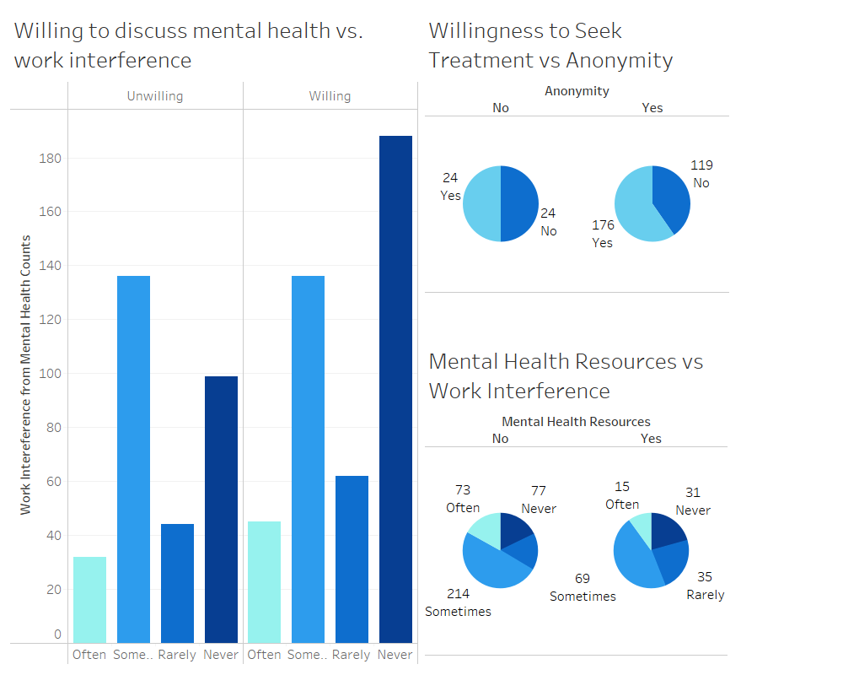

Slide 3
